Slide 1


1
PRE SCHOOL
TEAM NAME-ANALYSIS ACES
NAME-BALMIKI KUMAR
COLLEGE NAME-IIT GUWAHATI
EMAIL-balmiki4238@gmail.com
Frederik Laustsen I Mette Mathiasen I Rikke Damgaard I Tobias Brix

Slide 2




PRE SCHOOL SUMMARY
Situation
pre-school was started in 2020, COVID acted as a major setback for the business. The management struggled to run and expand the business during the initial stages. Later on they came up with Virtual-learning classes which was a huge hit! Although the progress was big, expansion of business was not possible back then. Now that things are back to normal, the pre-school is doing a great job in live classes with their outstanding curriculum and pedagogy.
S
Opportunity
the school has seen 125% rise in profit over the past 2 years because of new admission for the live classes, for the current academic year which is going to start in the month of June.
O
Q
Question
1.How should the pre-school be expanded to five tier-1 cities? What should be the strategy? What will be the program plan of expansion for the next 12 months? 2.What will be the marketing and branding strategies after launch and expansion 3.What will be the financial projection for the next one-year considering expansion.

Slide 3




3 Part Story EVA
Consulting
Strategy 1
USER PERSONA
WORKING COUPLE
GRANDPARENTS
SINGLE MOTHER
NAME PRITI SHUKLA
AGE 27 YEAR
LOCATION-DELHI
MOTIVATIONS-To give bright future to her child and to find activity that will keep her children busy and happy.
FRUSTRATIONS-Priti always feels like she has very little time to spend on study and she is rarely home and needs a solution that will allow her to easily work while on the go.
NAME-ANURAG AND ANANYA
AGE-32 &30
LOCTION-BANGALORE
MOTIVATIONS-Getting accepted into his top choice schools and choosing a school where he will have fun .
FRUSTATIONS-both are working couple ,they spent most of the time in their office so that they do not give proper time for their overall development and want such things.
NAME-ARITARO GONGULY AND MAHARANI
AGE-ABOVE -50
LOCATION-KOLKATA
MOTIVATIONS-learning valuable lessons like giving charity, being polite ,respectful to elders etc.
FRUSTRATIONS-they are unable to care the child due to poor health of itself.

Slide 4
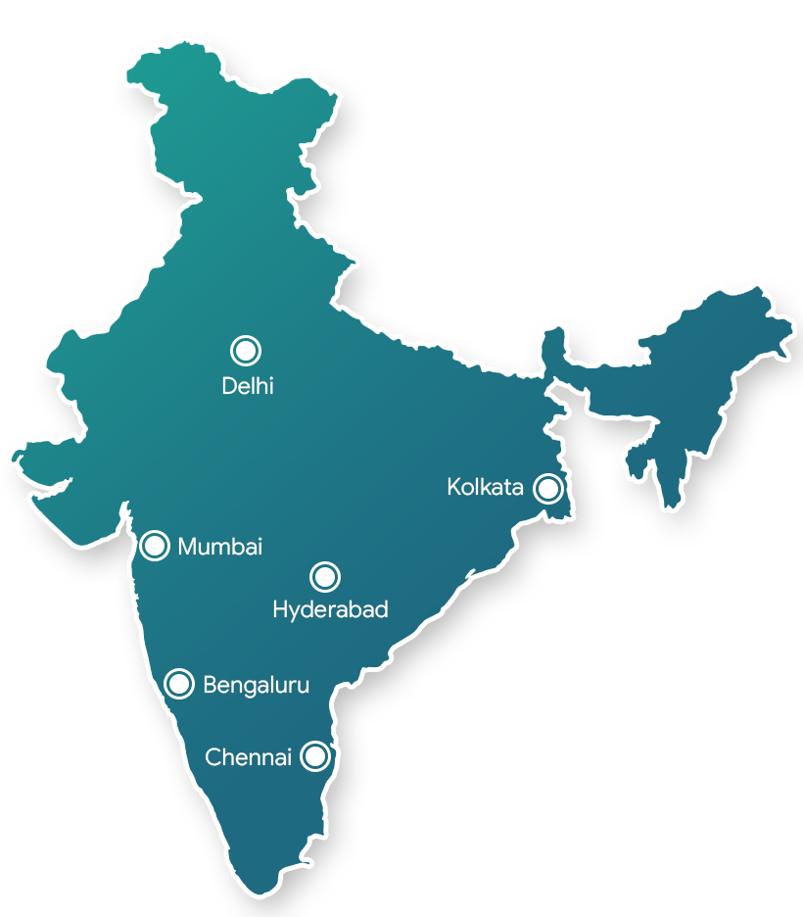
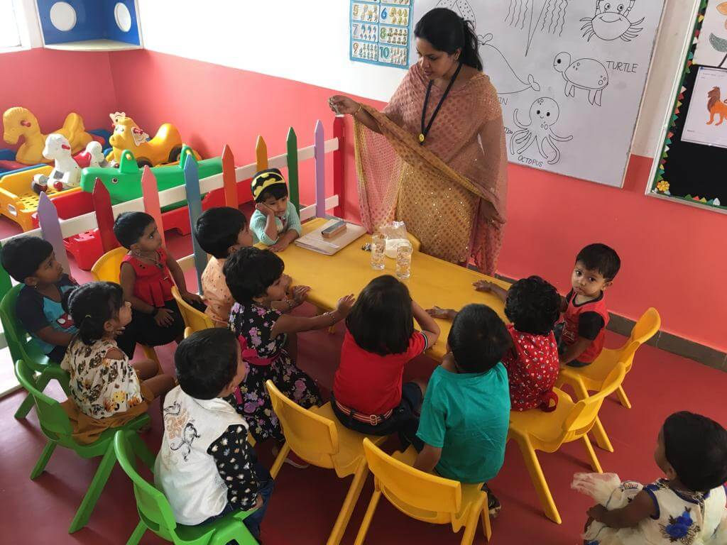

FIVE CITIES
LOCATION
RESIDENTIAL AREA having surrounded by family.
Area is well connected by roads around 5 to 8 km.
Better security in this area
Gardens and parks attract more parents and children.
we chose five different citis to explore their local culture and further expension is easy in whole india.

Slide 5


APPENDIX
STRATEGIES FOR PRE SCHOOL
Don’t SELL, Educate Parents
If you are thinking that you can sell to parents you are wrong. Today’s parents are well informed and educated. Parent’s need to be educated about education and its importance. As a school, you need to have a concern about the child’s education more than the parents only then parents will make the decision in your favor.
Don’t fall into PRICING traps
To support my point a report issued by Times Of India in 2012 mentioned: “India ranks 72 in global education survey out of 88 countries that participated in the survey”.
Focus on providing quality, streamline your process, improve your delivery, hire highly qualified teachers and interact with your parents very often.

Slide 6


APPENDIX
Awareness Program Initiatives
your pre school should always be in the limelight for supporting some cause. For example, start a breast cancer awareness initiative and run campaigns around it. This initiative should be a part of all your communications (online & offline).
Position your school as One Stop Solution in Education
parents take admission in preschool their concern is about admission to the higher school for grade 1.
Parents are concerned about donations, admissions procedures, interviews and so on. As a preschool, you can have a strategy wherein if the child takes an admission in playgroup or nursery and continues with the preschool for Lower Kindergarten (LKG) and Upper Kindergarten (UKG) the child will get direct admission into the high school i.e the parent school.

Slide 7
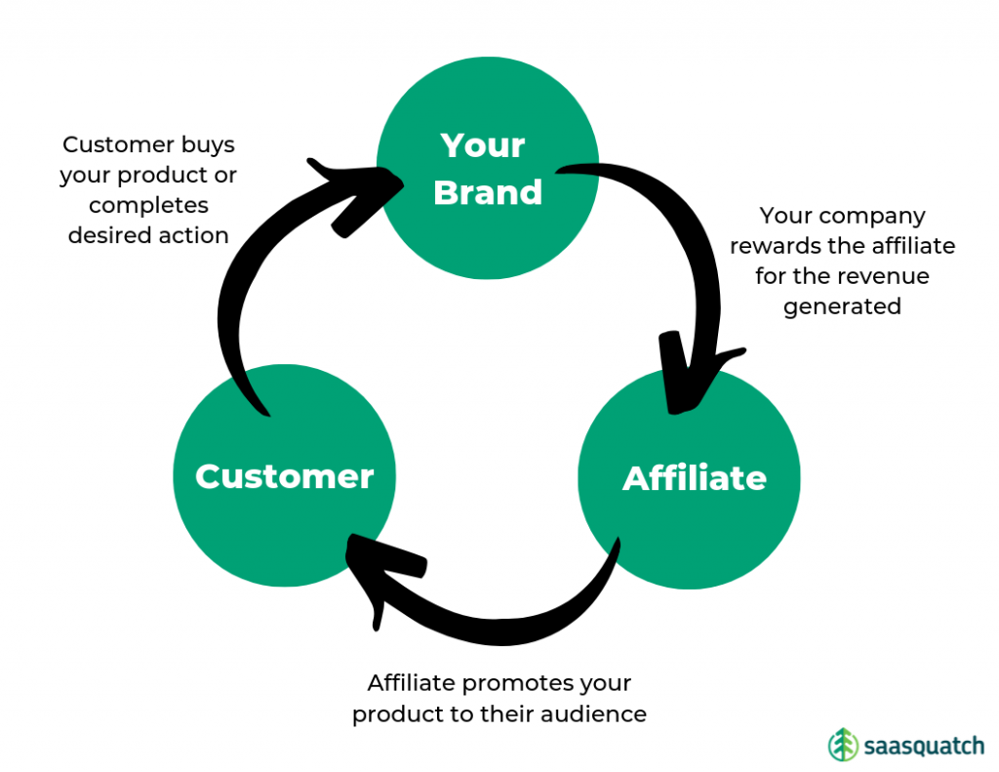

Introduce an AFFILIATE program
Affiliate marketing is slightly different from Referral marketing. The key difference between them is a monetary benefit.
I learned that the key decision makers for a child’s education are the mothers. Keeping this thought in mind I tied up my preschool (for one specific location) with a couple of parlors. Why parlors? Probably the only place where women have plenty of time to chit chat and relax (pun intended: p). As a marketer, I found an opportunity to make use of this time and introduce my schools to the mothers via the parlor owners, in this case, the parlor owner is my affiliate.
Engage with Parents
If Digital Marketing is not part of your current strategy you might lose your customers (parents) over a period of time.
In today’s scenario where social media has become a part of our daily life; as a school, you cannot ignore the opportunity to connect with parents on these mediums.
APPENDIX

Slide 8



Marketing & branding strategies
EVA
Being a preschool director centers on children's education, but to make a difference, first you need to get those kids in the door. That's why marketing and brand management are also a big part of the job.
PILLER OF MARKETING & BRANDING
Integration
Volunteer: You and staff should volunteer locally. Wear branded T-shirts and network with families during these times.
Community events: Sponsor a local 5K fun run or safety fair. Sign up to walk the local parades and pass out candy, bubbles or extras with your flyer information.
Social media: Your target market is savvy on social media. Maintain a preschool page with regular posts and consider engaging extras like photo contests.
Appendix

Slide 9



Website refresh: People will search to find you, so make sure you are using keywords to boost SEO . Include a mission statement and describe why your school is unique. Staff pages offer a personalized experience and parent recommendation statements underscore key messaging.
Host in-house events: Open free events to current families and the public in the evenings and weekends. parents' night out or craft project afternoon for kids. Hosting thought-leadership seminars on important topics, like ways to teach your child to read or how to stop bullying.
Branded products: Having your name on a variety of promotional items is a smart idea, but it can go beyond pens. Lifetouch Preschool Portraits offers some schools the opportunity to add branding to photography products, such as class pictures or graduation folios.

Slide 10

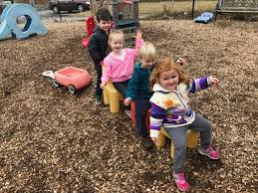

Vehicle magnets: This inexpensive marketing tool goes everywhere you do. Place on the side or back of your car and include the school logo, phone number and website. Ask if teachers would be willing to add one to their cars, too!
Tours and open houses: Advertise regular monthly tours or offer them by appointment throughout the year. If you only open your doors once a year for prospective families, they might turn elsewhere.
Word of mouth: One of the most powerful tools to advertise any brand is word of mouth. Encourage current families to spread the good word and offer incentives, like a free month of enrollment or a prize pack contest for anyone who gets a referral.
APPENDIX
Blogging: write posts about upcoming events, fun projects and other interesting subjects. Content marketing like this is huge right now. Make sure to post links to all blog updates on social media.

Slide 11

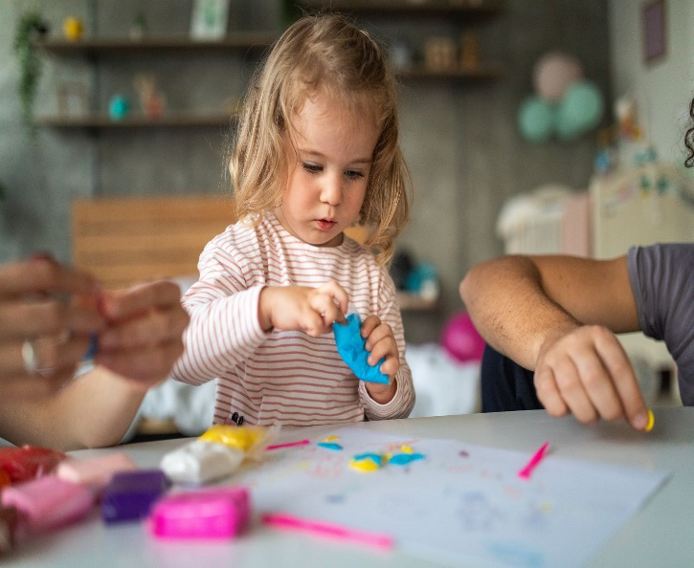



FINANCIAL PROJECTION
Lets take an example
TODDLER PROGRAM
No of stud=50
Fee=Rs1000/per months.
KINDER GARDEN
No of stud=100
Fee=2000/per months.
GRANDMA’S HOUSE
PLAY GROUP
No of stud=50
Fee=Rs1000/per months.
NURSERY
No of stud=100
Fee=2000/per months.

Slide 12
Total no of students=300
Class held 6 days per week and 4 hours in day
Financials
Fee=rs6000*12 months
=72,000 per year
Total revenue=fee*no of students
72000*300=21600000 per year
EXPANSES
1.Teacher salary=30,000*6 teachers*12months
=rs2160000 per year
2.RENT=200000*12
=2400000 per year
3.Support Staf, study materials, house keeping etc=500000 per year
4.toy,furniture etc=rs1000000
expenses= 6060000 per year
MARKETING
1.BILL BORDS(10-15 bill bords)=rs50,000 per bill bords
2.SEMINARS(5-7)=rs 40,000 per seminars
3.NEWSPAPER=rs500000
4.Other mode
COAST OF MARKETING=Rs30 to 50 lakhs to fill up 300 students
PROFIT=TOTAL REVENUE-TOTAL EXPENSES
21600000-11060000=Rs10,540,000 per years.
CUSTERMER ACQUISITION COAST=20 to 25 % of the revenue
CAC=Rs5000 to 7000 spend on student who are willing to pay 25,000.

